Slide 1

Assessment Demo
Vacation Requests Task

Slide 2
Agenda
System Design
Backend Architecture
Class Diagram
Code Walkthrough
Prototype Demo

Slide 3
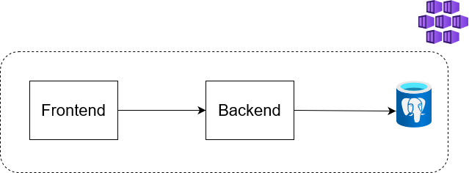
System Design
A frontend App (Blazor Server) communicating with a Backend Server (ASP.NET Core 7) through an SDK.

Slide 4
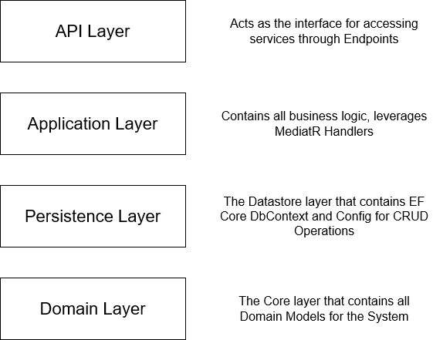
Backend Architecture
The backend is structured using N-Tier Architecture Pattern as follows

Slide 5
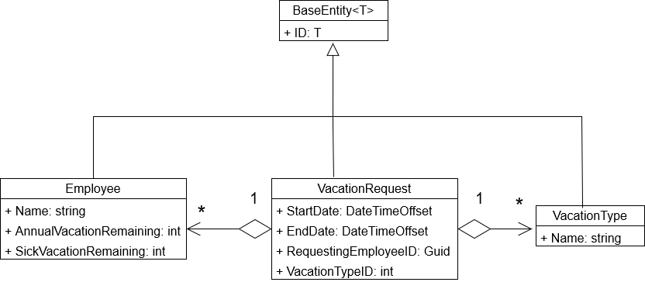
Class Diagram

Slide 6
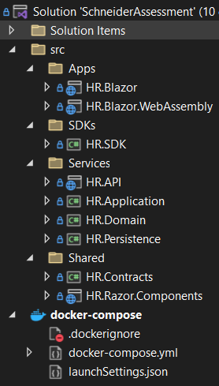
Code Walkthrough
Frontend Project
SDK Project
Backend Project and Layers
Shared Projects used by Frontend & Backend
Docker-Compose files

Slide 7
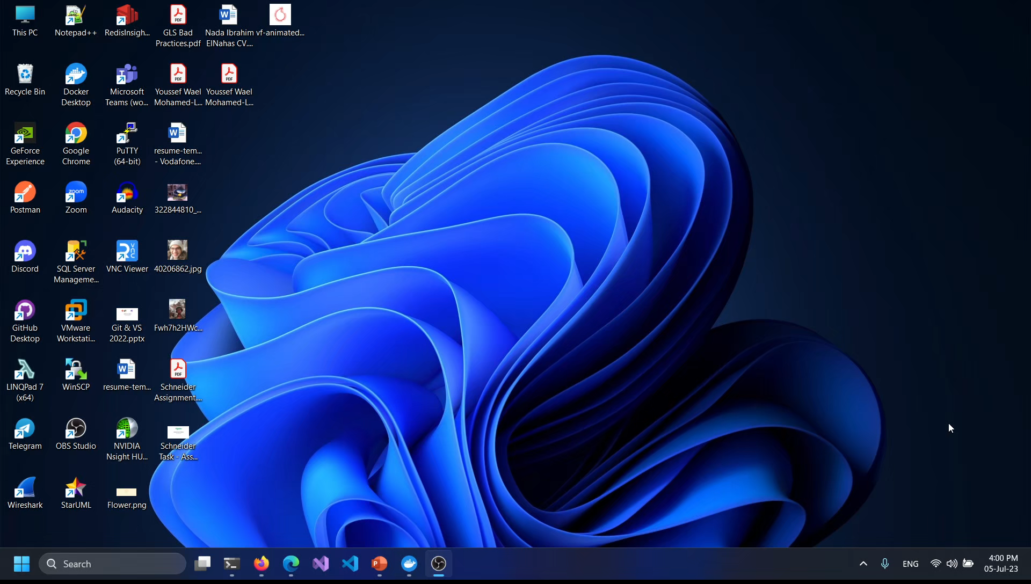
Prototype Demo

Slide 8
Thank you for the challenge
Hope you like it…
Click here to view Github Repo Link

